Slide 1
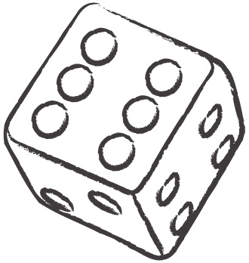
Basic Rules
One person at each table records and charts results for each round
Each other person rolls three dice per turn. This represents the work of the organization.
There are ten turns in a round
We will play three rounds, but stop and have a discussion after each round
|
|
1
2
3

Slide 2
Recorder Rules
For each round, keep a tally of the three types of success metrics at your table.
Total up after every round.
Use the the score sheet
After each round plot cumulative totals in a stacked line chart on the blank chart sheet
1st round
2nd round
3rd round
1
2
3
25
Example for round 1 using the tallies above
20
15
← 13 (6 + 7)
Count
10
← 7 (3 + 4)
5
← 4 (Type 1 success metric)
1st round
2nd round
3rd round
Round

Slide 3
Pick a New Rule
Before your team begins the second and third rounds, pick one of the new rule cards
Each card alters in some way how you roll the dice (i.e. how your organization conducts it’s mission)
These new capabilities take time to implement
Each card indicates in what turn the new ability comes into effect
You can only pick one for the entire team

