Slide 1
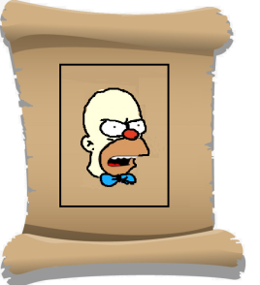
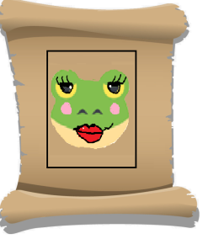
Clown is very angry and takes back his wig
and he punches your face before you blink .Now you will remain unconscious one turn. Please continue after that
…You can now roll the dice.
The dragon’s nail was very fake. He got it from a beauty shop. Wait 2 turns for the real nail to
grow up.
Your frog becomes female , she turns her face full make up! .
Because your frog is missing you wait one turn
then get back to “Start”you will get a male frog in the enchanted box.
Magic is here!
You can make one
missing ingredient
appear!
Sorry the politician wasn’t honest after all. Get back to “Start” and get a new tie from enchanted box.
Witch Police at the entrance !!!
it is time to check your bag,
If you don’t have all ingredients you are sent to the “Start”

