Slide 1
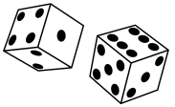
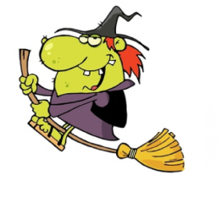
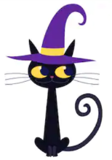
Rules
Each witch can roll the dice
only once per turn.
Each witch must arrive to the castle with all ingredients.
No brooms (or flying).
No magical creatures.
No Magic.

