Slide 1
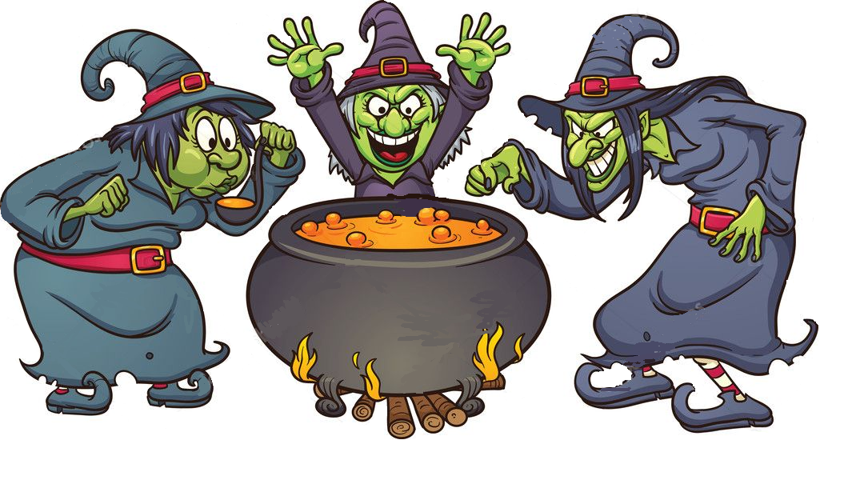
Ingredients
Cute Spider
Clowns Wig
Male Frog
Tie of a honest
Politician
Real dragon’s nail (red painted)

